Slide 1
Hackathon
Notes:
Quick transition:
"So with all this change and scale, things WILL go wrong.
The question isn't 'will something fail?' — it's 'what happens when it does?'
This brings us to two concepts that are critical in production systems..."
Note the difference (from your existing notes):
- Robustness: maintaining functionality under stress/variations
- Resilience: recovering quickly from faults

Slide 2

The Challenge!
https://github.com/man-group/man-imperial-algothon-2026/tree/main
We’ll release data every approximately 2h
You need to submit your allocations for each instrument before each release
Your allocations need to sum up to 1.0 and be >= 0.0
You need to maximise the out of sample sharpe (return / std)
Create a CSV named `{team_name}_round_{N}.csv`:
```csv
asset,weight
INSTRUMENT_1,0.15
INSTRUMENT_2,0.10
INSTRUMENT_3,0.05
INSTRUMENT_4,0.05
INSTRUMENT_5,0.20
INSTRUMENT_6,0.10
INSTRUMENT_7,0.15
INSTRUMENT_8,0.05
INSTRUMENT_9,0.10
INSTRUMENT_10,0.05
```
Notes:
This is the slide that will resonate most with CS/ML students.
"Let's talk about something you all experience every day: news.
THE SPEED: When a company reports earnings, the price moves BEFORE any human
can read the report. Algorithms are parsing the numbers, comparing to expectations,
and trading — all in milliseconds.
But speed isn't everything. Some news is complex:
- A central bank says something ambiguous — is it hawkish or dovish?
- A CEO's tone on an earnings call is nervous — even though the numbers are fine
- A geopolitical event could go either way
This is where NLP and LLMs are transforming quant finance right now.
WHAT WE DO:
- We process thousands of news articles, earnings transcripts, and social media posts daily
- We use NLP to extract sentiment, topics, and entities
- The key question isn't just 'is this good or bad?' but 'is this SURPRISING?'
- A great earnings report that everyone expected won't move the price.
A mediocre report that's better than feared will.
THE EFFICIENT MARKETS ANGLE:
- Textbook says: prices reflect all available information instantly
- Reality: prices reflect MOST information MOSTLY quickly
- The 'mostly' is where quants make money
- Some information takes hours or days to be fully priced in
- Alternative data (satellite imagery, credit card data) isn't available to everyone"
ENGAGEMENT: "For the hackathon, think about what data sources others might NOT be using.
Everyone will look at price data. What about sentiment? What about alternative data?"

Slide 3

Momentum Signals
The idea: assets going up tend to keep going up (and vice versa)
Momentum return (lookback k):
$$r_{i,t}^{\left(k\right)} = \frac{P_{i,t} − P_{i,t−k}}{P_{i,t−k}}$$
Signal strength (vol-normalised):
$$s_{i,t} = \frac{r_{i,t}^{\left(k\right)}}{{\hat{σ}}_{i,t}}$$
Position sizing:
$$w_{i,t} = sign\left(s_{i,t}\right) · f\left(\left|s_{i,t}\right|\right)$$
Time-Series (Trend Following)
• Look at an asset's OWN past returns over a lookback window k
• AHL has been doing this since the 1980s
Cross-Sectional
• Rank assets against each other: long winners, short losers
• Market-neutral — you're betting on relative strength
Notes:
ENGAGEMENT: "How many of you have heard of trend following?"
Key narrative:
"Momentum is one of the most robust anomalies in finance. The idea is simple:
winners keep winning, losers keep losing. At least for a while.
TIME-SERIES MOMENTUM (Trend Following):
- You look at each asset individually. Has gold been going up? Buy more gold.
- AHL was founded on this in the 1980s. It's simple in concept, hard in execution.
- You need to decide: what lookback period? How do you size the bet? When do you cut?
CROSS-SECTIONAL MOMENTUM:
- Instead of looking at one asset's history, you RANK assets against each other.
- Top performers get a long position, bottom performers get shorted.
- This is market-neutral — you don't care if the overall market goes up or down.
THE HARD PART:
- Momentum strategies suffer from 'crashes' — sudden, violent reversals.
- 2009: momentum crashed spectacularly. Why? Everyone was in the same trade.
- This is an active area of research: how do you detect when momentum is about to break?"
ENGAGEMENT: "In your hackathon, if you build a momentum signal, think about what
makes YOUR version different from everyone else's. That's the edge."

Slide 4

Portfolio Construction
A good signal is only half the battle — how you BUILD the portfolio matters as much
Key decisions:
Risk budgeting — how much risk does each signal get?
Correlation — signals that always agree add no diversification
Transaction costs — the best signal is useless if it trades too much
Constraints — position limits, leverage, liquidity
Markowitz Mean-Variance Optimisation
Mean-Variance Optimisation (Markowitz):
$$\max_{w} w^{T}μ − \frac{λ}{2} w^{T}Σw$$
Constraints:
$$s.t. \sum_{i}{w_{i}} = 1, w_{i} ≥ 0$$
Notes:
This is the slide that separates quant beginners from quant thinkers.
"Everyone at a hackathon focuses on the SIGNAL — the alpha, the prediction.
And that's important. But in the real world, portfolio construction often
matters MORE than the signal itself.
Here's why:
RISK BUDGETING: If you have 10 signals, how much capital does each one get?
Equal weight? Proportional to confidence? Proportional to past performance?
Each choice has trade-offs.
CORRELATION: If two signals always say 'buy' at the same time, you're
effectively running one signal, not two. Diversification is about finding
signals that DISAGREE as much as they agree.
CONSTRAINTS: In the real world, you can't just 'go long $1 billion of a stock
nobody trades'. Liquidity matters. Leverage limits matter. Regulatory limits matter.
TRANSACTION COSTS: A signal that flips from long to short every day might look
amazing in a backtest — but in reality, you'd lose everything to bid-ask spreads
and market impact.
THE TETRIS ANALOGY: Each signal is a piece. Individually they might be great,
but you need them to FIT together. A portfolio of mediocre but uncorrelated
signals beats a portfolio of great but correlated signals."
ENGAGEMENT: "For your hackathon, don't just think about the signal. Think about
how it combines with other ideas. That's what judges will be impressed by."

Slide 5
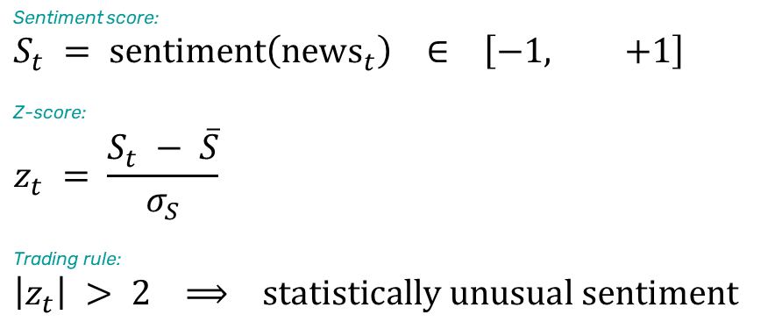
How News Moves Markets
Markets don't wait — prices react to information in seconds
The Information Cascade
• Event happens → algos parse it in milliseconds → price moves
• Humans read the headline 30 seconds later. Markets have already moved.
Quantifying Sentiment with a Z-Score
Sentiment score:
$$S_{t} = sentiment\left({news}_{t}\right) ∈ \left[−1, +1\right]$$
Z-score:
$$z_{t} = \frac{S_{t} − \overline{S}}{σ_{S}}$$
Trading rule:
$$\left|z_{t}\right| > 2 ⟹ statistically unusual sentiment$$
The key question: is this news SURPRISING? Expected news doesn't move prices.
Notes:
This is the slide that will resonate most with CS/ML students.
"Let's talk about something you all experience every day: news.
THE SPEED: When a company reports earnings, the price moves BEFORE any human
can read the report. Algorithms are parsing the numbers, comparing to expectations,
and trading — all in milliseconds.
But speed isn't everything. Some news is complex:
- A central bank says something ambiguous — is it hawkish or dovish?
- A CEO's tone on an earnings call is nervous — even though the numbers are fine
- A geopolitical event could go either way
This is where NLP and LLMs are transforming quant finance right now.
WHAT WE DO:
- We process thousands of news articles, earnings transcripts, and social media posts daily
- We use NLP to extract sentiment, topics, and entities
- The key question isn't just 'is this good or bad?' but 'is this SURPRISING?'
- A great earnings report that everyone expected won't move the price.
A mediocre report that's better than feared will.
THE EFFICIENT MARKETS ANGLE:
- Textbook says: prices reflect all available information instantly
- Reality: prices reflect MOST information MOSTLY quickly
- The 'mostly' is where quants make money
- Some information takes hours or days to be fully priced in
- Alternative data (satellite imagery, credit card data) isn't available to everyone"
ENGAGEMENT: "For the hackathon, think about what data sources others might NOT be using.
Everyone will look at price data. What about sentiment? What about alternative data?"

Slide 6
Important information
This material is of a promotional nature.
This information is communicated and/or distributed by the relevant Man entity identified below (collectively the "Company") subject to the following conditions and restriction in their respective jurisdictions.
Opinions expressed are those of the author and may not be shared by all personnel of Man Group plc (‘Man’). These opinions are subject to change without notice, are for information purposes only and do not constitute an offer or invitation to make an investment in any financial instrument or in any product to which the Company and/or its affiliates provides investment advisory or any other financial services. Any organisations, financial instrument or products described in this material are mentioned for reference purposes only which should not be considered a recommendation for their purchase or sale. Neither the Company nor the authors shall be liable to any person for any action taken on the basis of the information provided. Some statements contained in this material concerning goals, strategies, outlook or other non-historical matters may be forward-looking statements and are based on current indicators and expectations. These forward-looking statements speak only as of the date on which they are made, and the Company undertakes no obligation to update or revise any forward-looking statements. These forward-looking statements are subject to risks and uncertainties that may cause actual results to differ materially from those contained in the statements. The Company and/or its affiliates may or may not have a position in any financial instrument mentioned and may or may not be actively trading in any such securities. Unless stated otherwise all information is provided by the Company. Past performance is not indicative of future results.
Unless stated otherwise this information is communicated by the relevant entity listed below.
United Kingdom: Unless indicated otherwise this material is communicated in the United Kingdom by Man Solutions Limited ('MSL') which is a private limited company registered in England and Wales under number 3385362. MSL is authorised and regulated by the UK Financial Conduct Authority (the 'FCA') under number 185637 and has its registered office at Riverbank House, 2 Swan Lane, London, EC4R 3AD, United Kingdom.

